Slide 1
BIOMARKER

Slide 2
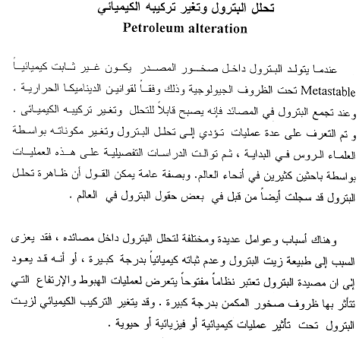

Slide 3
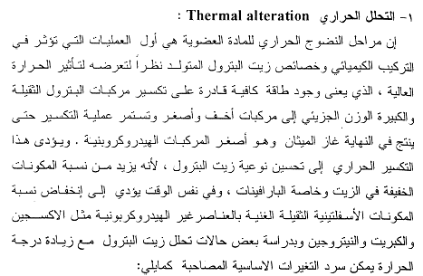

Slide 4
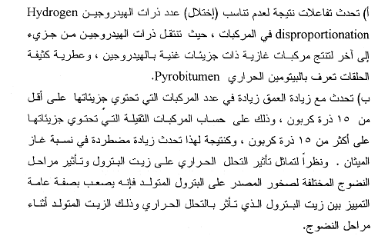

Slide 5
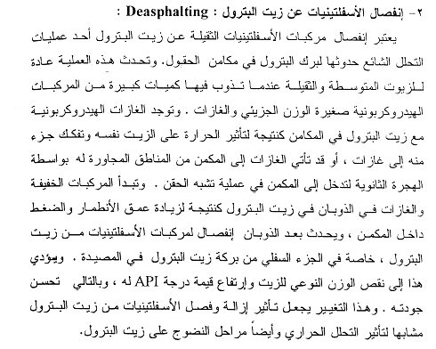

Slide 6
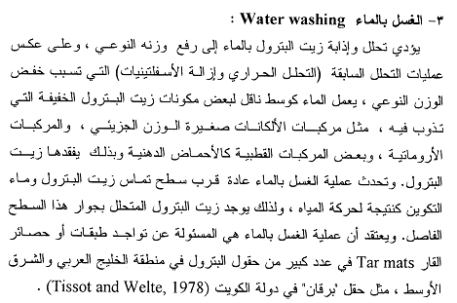

Slide 7
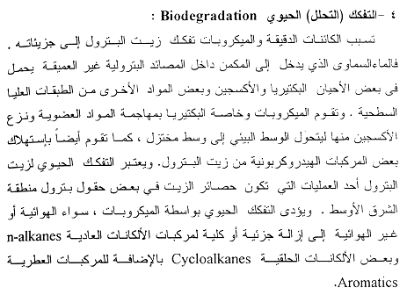

Slide 8
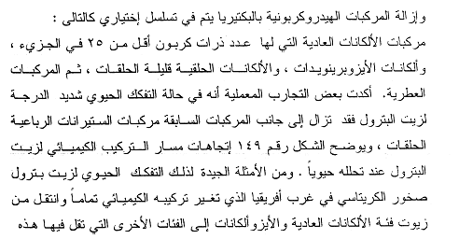
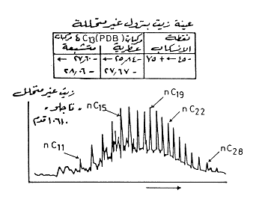

Slide 9
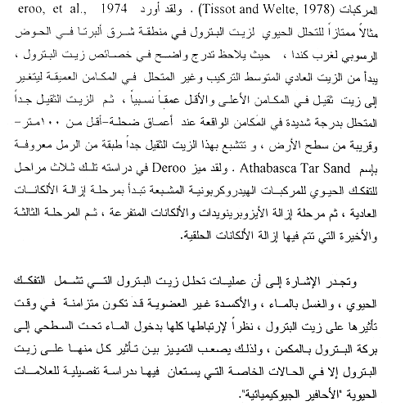

Slide 10
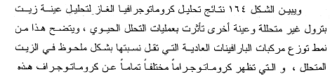

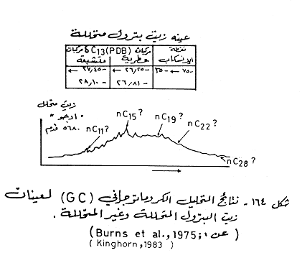

Slide 11
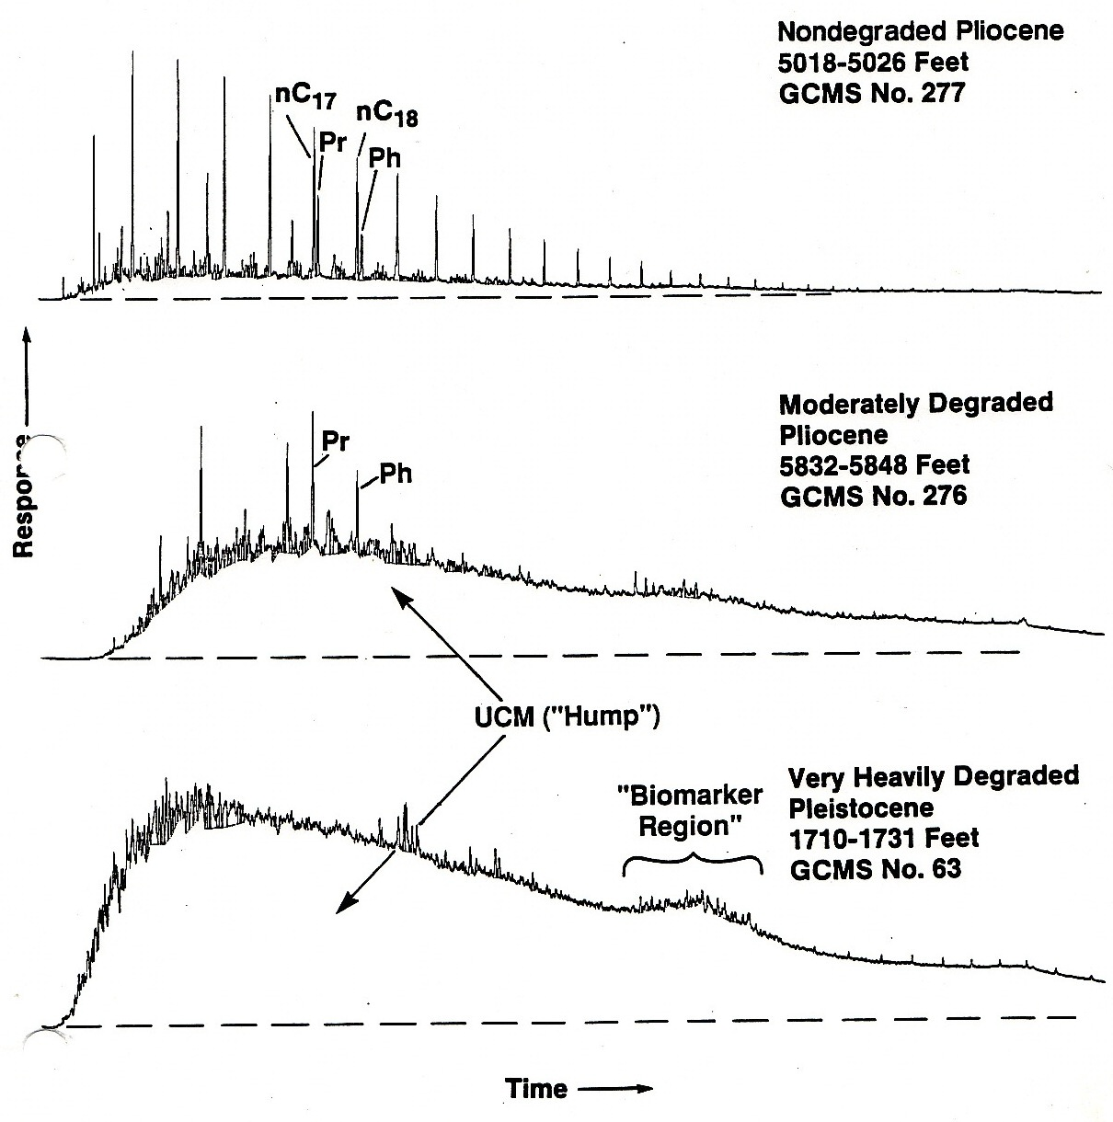
Gas Chromatography aplication in Biodegradation

Slide 12
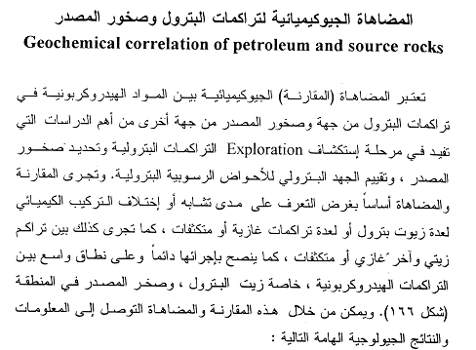

Slide 13
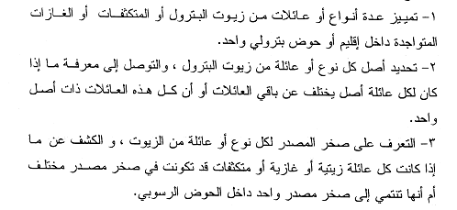
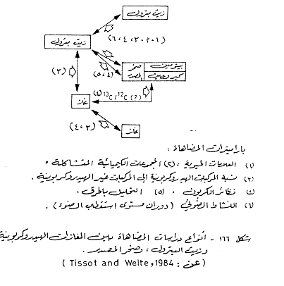

Slide 14
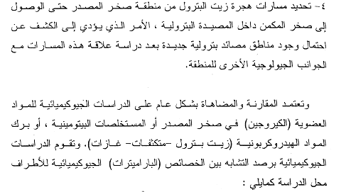

Slide 15
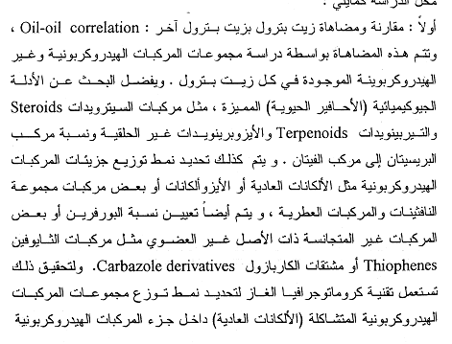

Slide 16
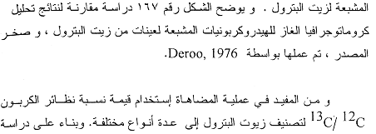


Slide 17
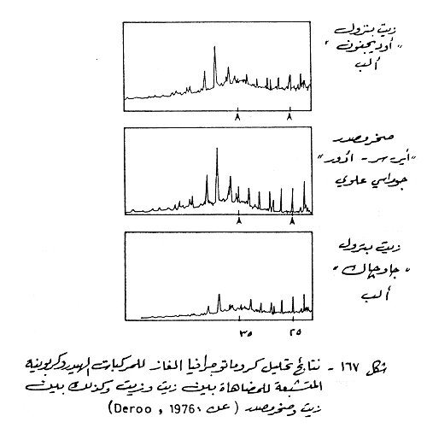

Slide 18
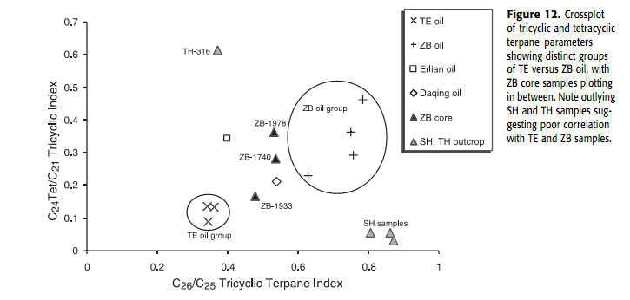

Slide 21
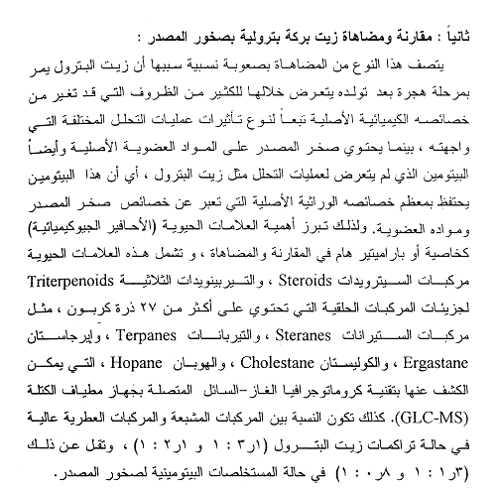

Slide 22
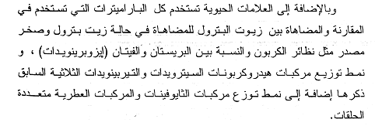

Slide 23
Petroleum Geochemistry
Petroleum geochemistry has become an important pool for reservoir characterization studies and providing information to reservoir and production engineers. However for the geologist and engineers that have not exposured to this type of geochemistry, it will be necessary to review these topics:

Slide 24
Bulk characteristics
API gravities
It is measurement of density or specific gravity of crude oils and it can be calculated as: (Waples, 1985)
API gravity is bulk physical property of oils that can be used as crude indicator of thermal maturity. During thermal maturity heavy compounds in oils, NSO compounds asphaltens and heavy saturated and aromatic compounds undergo increased cracking resulting in increased API gravity (Peters et al., 2005). It is affected by other factors such as original organic matter input, biodegradation, water washing, migration and evaporation. API gravity range scale (0 - 60°) where heavy or dense oils have low value and less dense oils or condensates have high values (Peters et al., 2005). API gravity for heavy oil and brine ((-8)-5) and have value 10 for heavy oil and fresh water and (15-20) for heavy oil and value (30-40) for light oil and 50 for condensate fluids (Tiab and Donaldson, 2004).

Slide 27
Sulfur content
It is a bulk parameter commonly used to evaluate the economics of refinery operations or to support inferred genetic relationships among crude oils (Peters et al., 2005). The sulfur compounds are usually the most abundant NSO compounds in petroleum. They can be subdivided into several chemical groups (Peters et al., 2005). Thiols, disulfides, thiaalkanes (sulfids), etc. Sulfur is typically higher in type II compared with other kerogen types. You can know the source input for sulfur. It is high sulfur oils connected with carbonate and low sulfur oil connected with terrestrial clastics. From Table (4-3) values of (%S) refer to oils of sulfur rich and the type of kerogen is kerogen II, Fig. (4-14). Tissot and Welte (1984) suggested that oils with low sulfur contents less than 1 classified as paraffinic, paraffinic naphthenic or naphenic classes, while oils of high sulfur (more than unity) belongs to the aromatic intermediate class, in addition, the sulfur content decreases with increasing maturity.

Slide 29
Stable carbon isotope
Stable isotope composition of carbon, sulfur, nitrogen and hydrogen (Kaplan, 1975). The stable carbon isotope used in many studies as indicator of the depositional environment, and as a tool of the depositional environment, and as a tool in oil-oil and oil-source correlations (Alexander et al., 1981). Isotopes are atoms whose nuclei contain the same number of protons but different number of neutrons (Peters et al., 2005

Slide 30
Sofer (1984) suggested that the isotope composition of oils could change owing to maturation and possibly migration effects and due to minor in homogeneities in the source material. In addition, he recognized the isotopic composition of carbon including C15 + saturated and C15 + aromatic hydrocarbon fractions, and connects relationships between them to estimate the source input by following equations: (Sofer, 1984)

Slide 31
The difference between the two equations was evaluated statistically and a statistical parameter, CV (the canonical variable) ( ).
It was used to distinguish between marine and terrigenous oils (Sofer, 1984). CV values larger than 0.47 indicate predominantly a terrigenous organic source for the oil, whereas CV values smaller than 0.47 indicate mostly marine organic source (non-waxy). The CV represents the perpendicular distance of sample from the best separating line between terrigenous and marine oils on plots of δ¹³C_{saturates} versus δ¹³C_{aromatic}, more negative CV indicate more marine input and vice versa (Peters et al., 2005).

Slide 32
